Slide 1










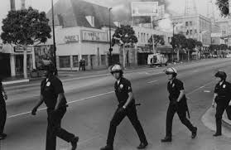



PREDICTING LA’S CRIMINALS
BY MAURICIO PALLARES, DEAN ROGGENBAUER,
& MAX VALLADOLID

Slide 2
TABLE OF CONTENTS
1
DATA OVERVIEW & GOAL
2
DATA ANALYSIS
3
MODELs & RESULTS
4
CONCLUSION

Slide 3
DATA OVERVIEW
TIMEFRAME
2020 - 2025
ARREST CASES
297,000 + cases
AGEs
18 years & older only
DISTRIBUTION
80% Males 20% Females
Hispanic White
African American
ETHNICITIES

Slide 4

PROJECT GOAL
Establish a Model that will accurately predict the demographics of an individual who will be arrested.
Age, Gender, and Ethnicity

Slide 5
DATA ANALYSIS

Slide 6
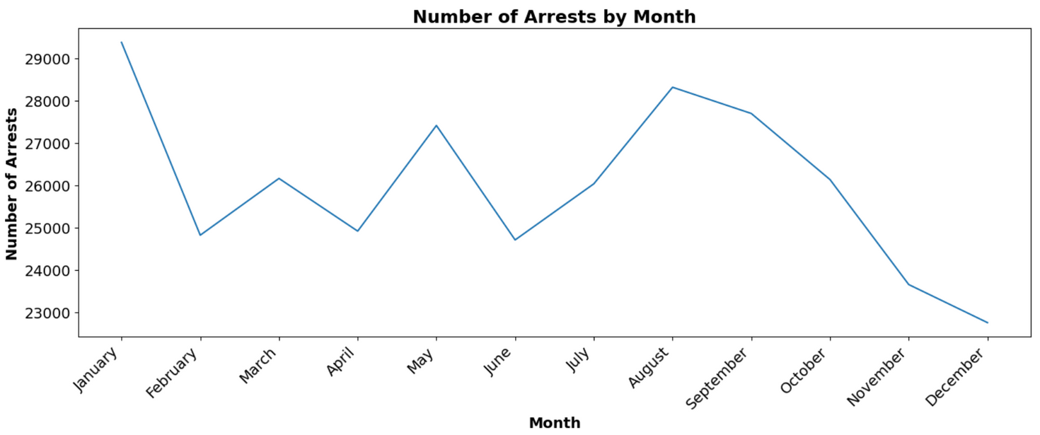
AVERAGE ARREST BY MONTH
2020-2025
Jan, May, August highest arrest count
Lower Arrest rates in the 4th quarter

Slide 7
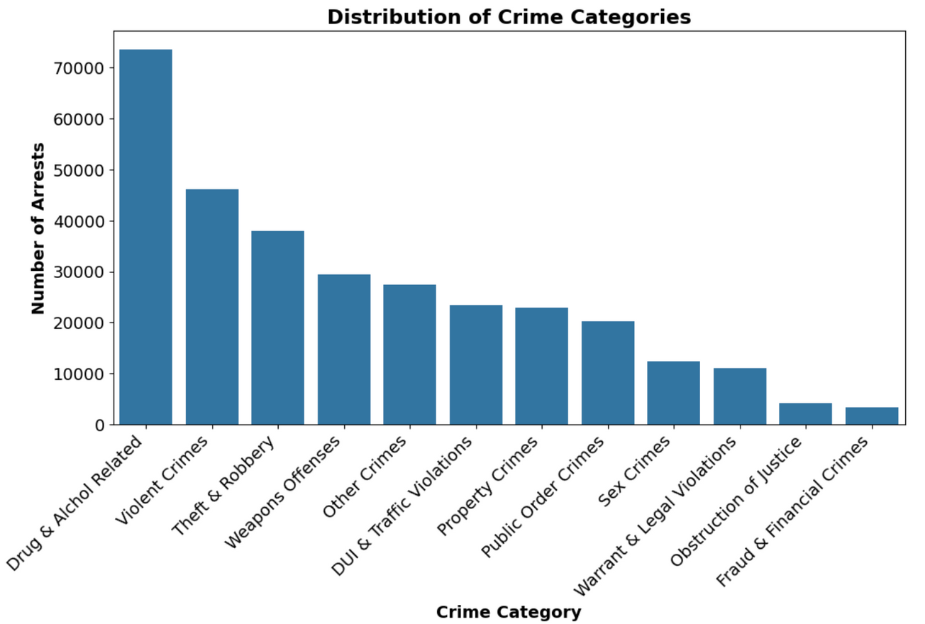
CRIME CATEGORY TYPE

Slide 8
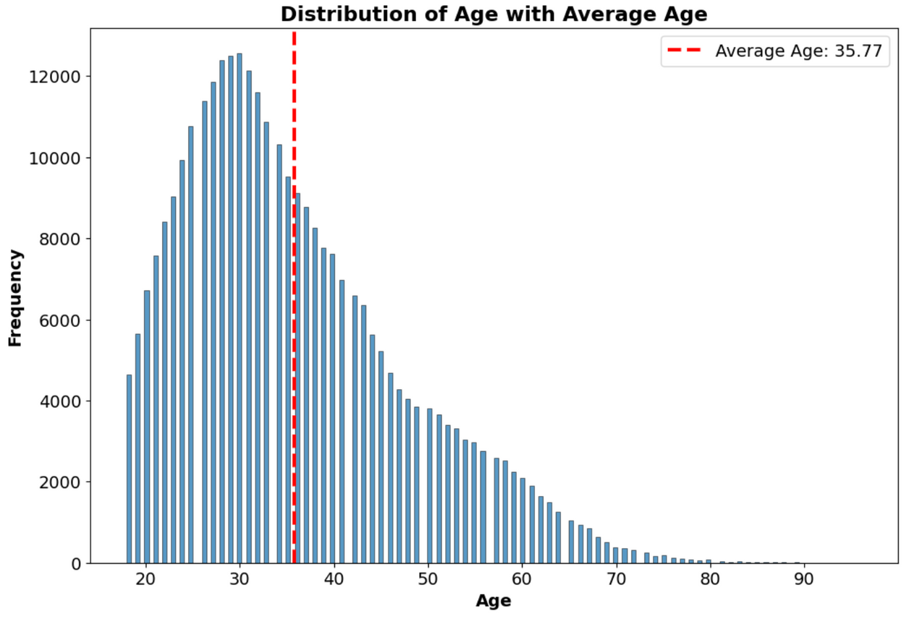
AGE DISTRIBUTION
Average Age
Overall
36 yrs
Males
36 yrs
Females
34 yrs

Slide 9
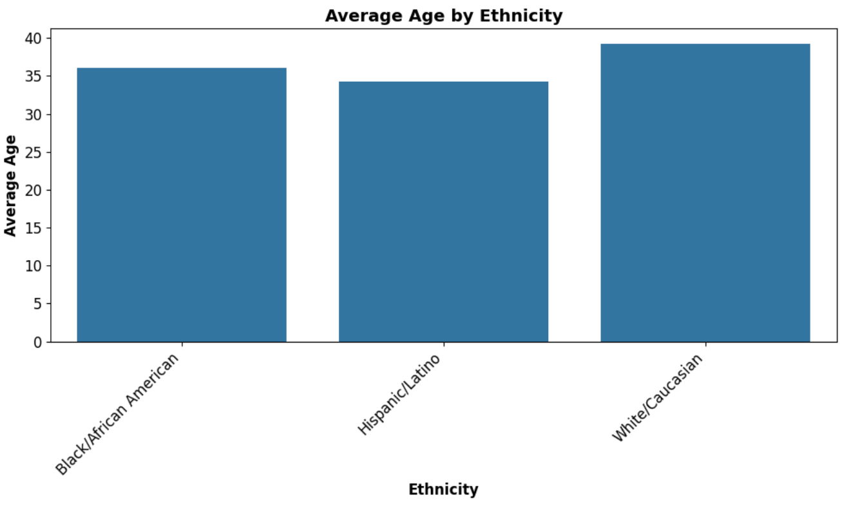
AGE BY ETHNICTY
Average Age
Black/African American
36 yrs
Hispanic/Latino
34 yrs
White/Caucasian
39 yrs

Slide 10
MODELS

Slide 11

PREDICTING DEMOGRAPHICS
Combine the results of three different models to get demographic predictions:
Gender
Age
Ethnicity

Slide 12
Process
Modeling
Data Cleaning
Feature Engineering
SMOTE
GridSearchCV
Trained Model

Slide 13
Process
Modeling
For all three of the targets, we created multiple models that were ensembled at the end.
Example
XGBoost
Soft Voting
Voting Classifier
Decision Tree
Random Forest
Hard voting

Slide 14
SMOTE & Grid Search
Modeling
Synthetic Minority Oversampling Technique (SMOTE)
Increases the number of cases in your dataset in a balanced way.
Generates new instances from existing minority cases that you supply as input.
GridSearchCV
Get best model hyperparameters
Works by testing multiple combinations of hyperparameters

Slide 15
GENDER

Slide 16


Tuning
GENDER MODEL
GridSearchCV
n_estimators = 100
min_samples_split = 2
min_samples_leaf = 4
class_weight = 'balanced'
Random Forest Classifier
SMOTE to balance since 80% was males and 20% was females
Notes:
Mention why Random Forest Classifier

Slide 17
Random Forest
Results
Other Models
Decision Tree: ~0.80
More even split between males and females
XG Boost: ~0.84
Similar split to RF
Ensemble: ~0.83
Similar split to RF
Accuracy: ~0.85
MALES
Precision = ~0.79
Recall = ~0.97
FEMALES
Precision = ~0.96
Recall = ~0.73
Notes:
Mention why Random Forest Classifier

Slide 18
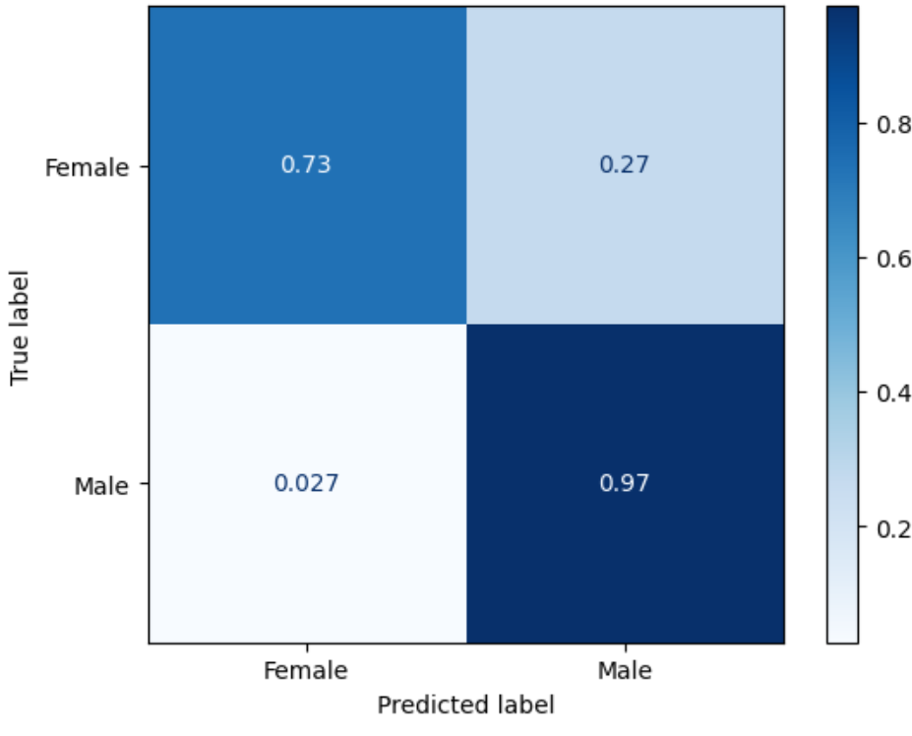
Random Forest
Gender

Slide 19
Reasons:
Where the model struggles
Reporting Day and Booking Day have spikes on days 1, 15, and 30 suggesting the model is picking up un-intended patterns in the data
Predicting that Females are actually Males
Some Area ID’s and Reporting Districts are predominantly male in training data leading to incorrect predictions
Notes:
Mention why Random Forest Classifier

Slide 20
AGE

Slide 21

Data prep
Age
Predicting between two age groups based on the median (33):
Younger Adults
18 - 33
Older Adults
33+
Attempted multiple approaches
More Age Groups (18-25, 26-35, ...)
Regression

Slide 22
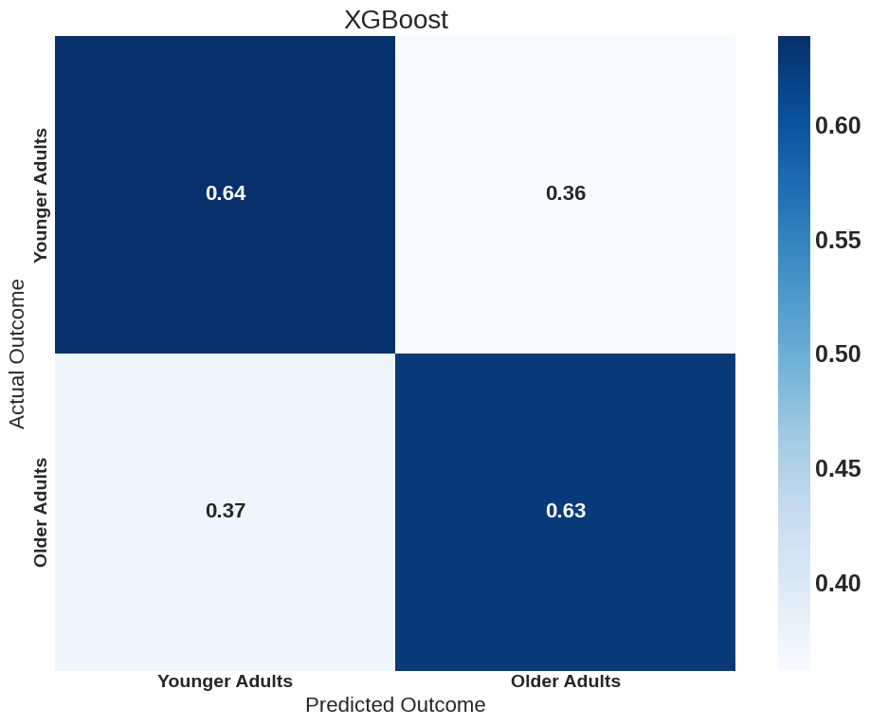
XGBoost
Age
Accuracy: 0.63
F1 Score Younger Adults: 0.64
F1 Score Older Adults: 0.63
GridSearchCV
learning_rate: 0.1
max_depth: 7
n_estimators: 200

Slide 23
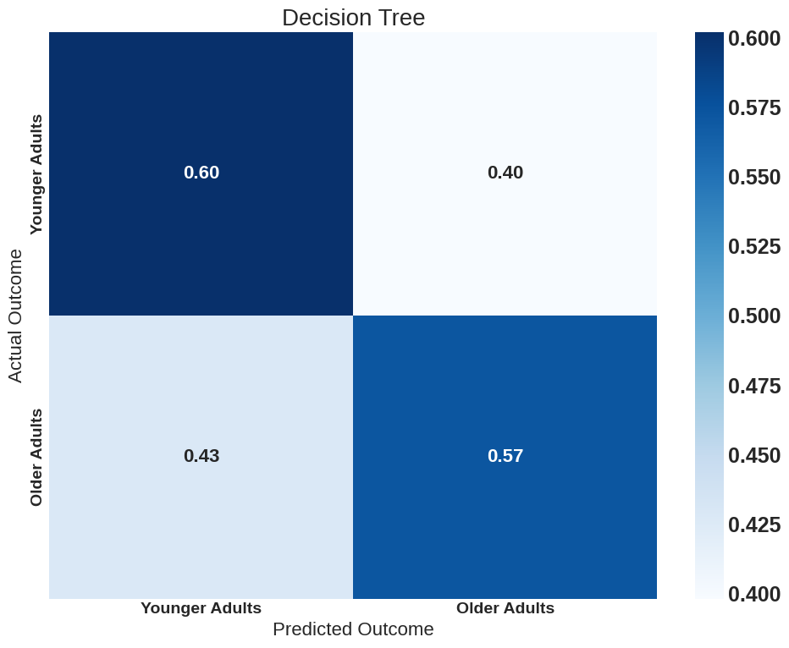
Decision Tree
Age
Accuracy: 0.59
F1 Score Younger Adults: 0.60
F1 Score Older Adults: 0.58
GridSearchCV
max_depth: 25
min_samples_split: 50
min_samples_leaf: 5

Slide 24
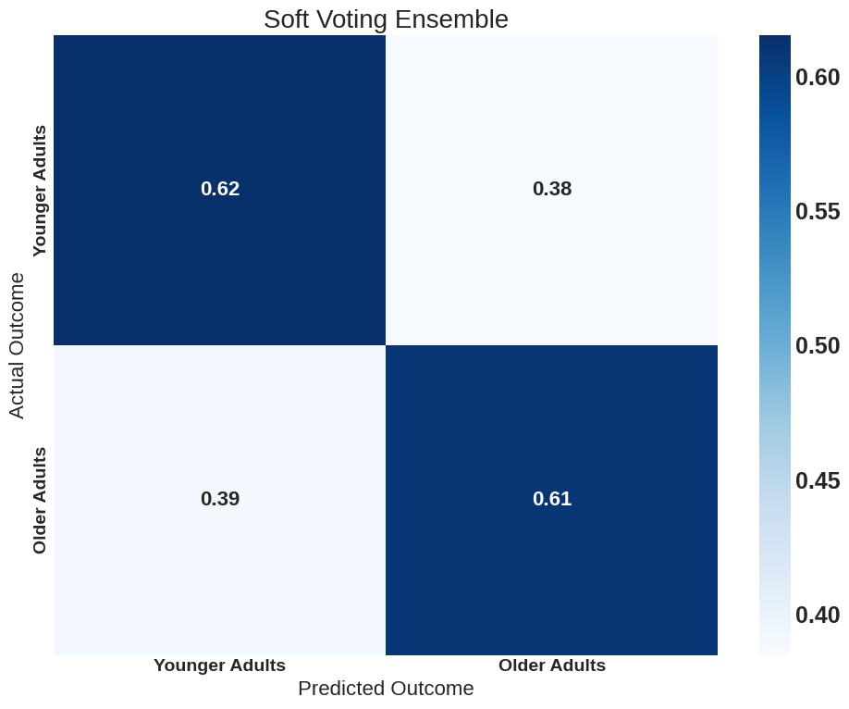
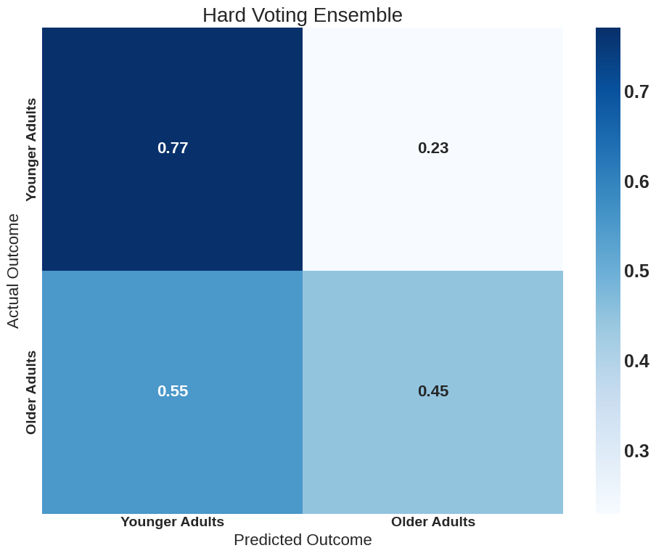
ENSEMBLE
Age
Soft Voting is balanced, but worse than just XGBoost
Hard Voting gets a significant improvement on predicting Younger Adults at the expense of greatly reducing the performance on Older Adults

Slide 25
ETHNICITY

Slide 26

DATA PREP
ETHNICITy
Predicting between three ethnicities:
Black/African American
White/Caucasian
Hispanic/Latino
Others dropped due to low numbers.

Slide 27
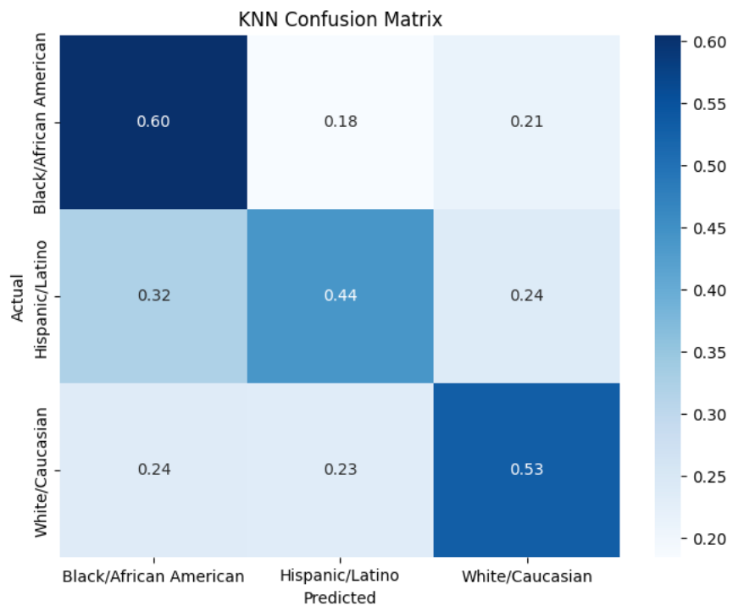
NEAREST NEIGHBORS
ETHNICITY
Accuracy: 0.53
F1 Score Black: 0.59,
F1 Score Hispanic: 0.44,
F1 Score White: 0.54
GridSearchCV
What does k mean?
How many neighbors to look at before making a decision
Optimal “k” = 35

Slide 28
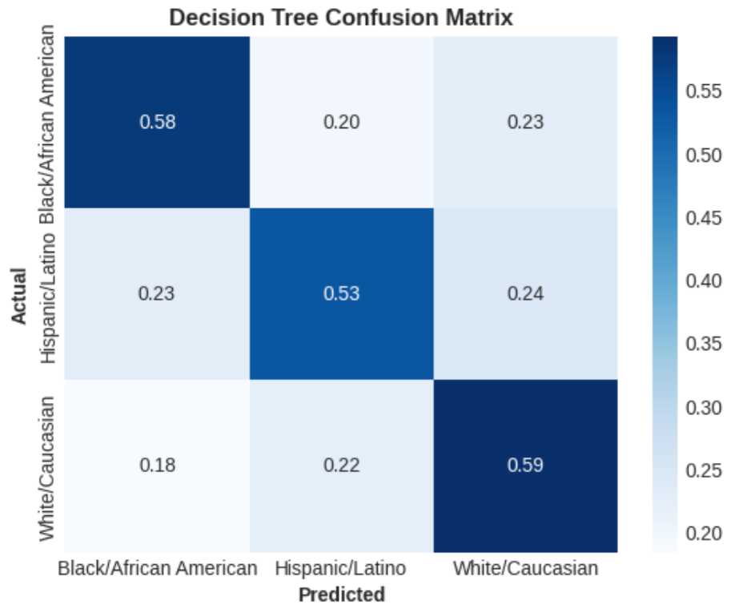
DECISION TREE
ETHNICITY
Accuracy: 0.57
F1 Score Black: 0.58
F1 Score Hispanic: 0.53
F1 Score White: 0.60
GridSearchCV
max_depth: 25
min_samples_leaf: 100
min_samples_split: 5

Slide 29
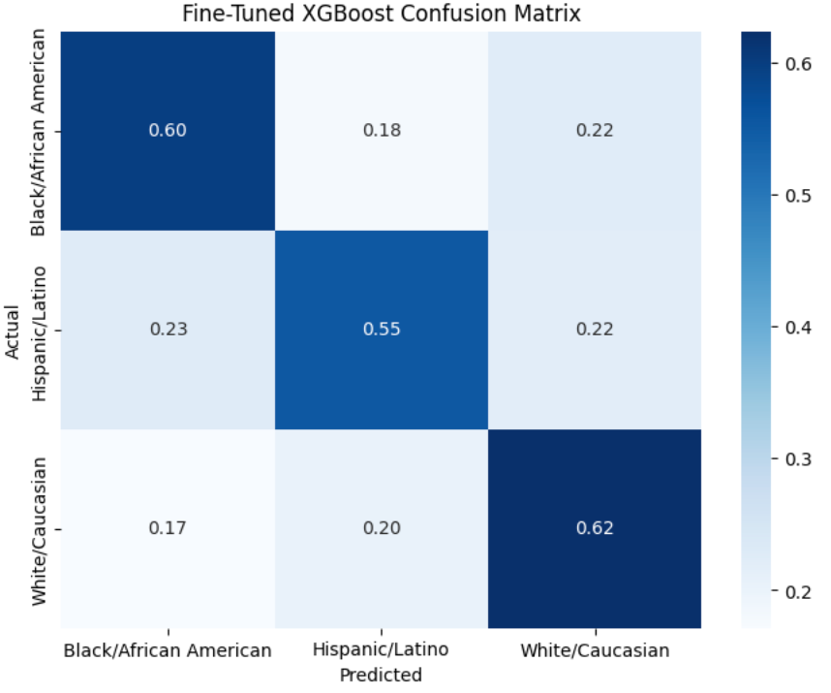
XGBOOST
ETHNICITY
Accuracy: 0.59
F1 Score Black: 0.60
F1 Score Hispanic: 0.56
F1 Score White: 0.60
GridSearchCV
learning_rate: 0.08
max_depth: 7
n_estimators: 150

Slide 30
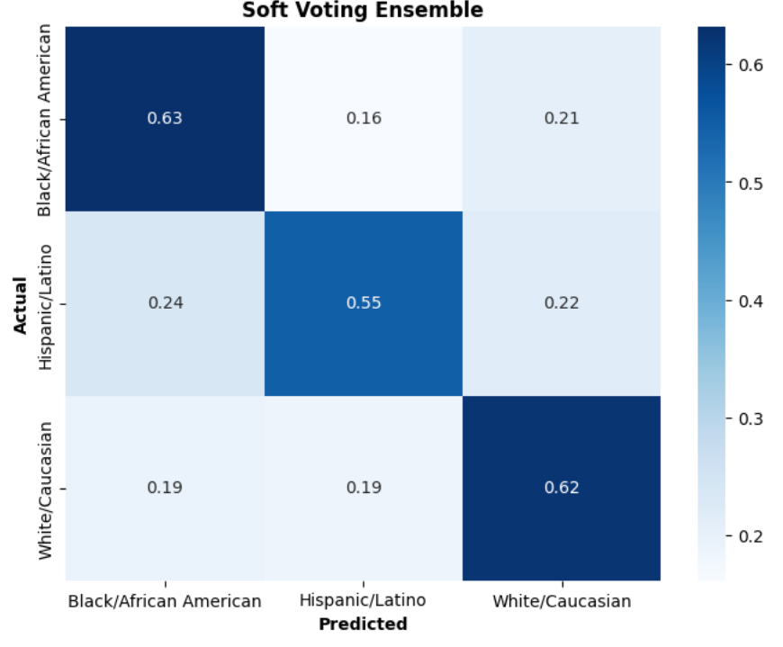
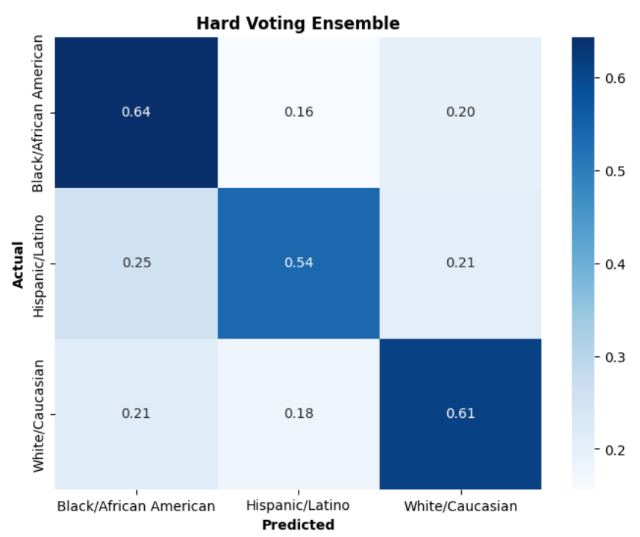
Ensemble
ETHNICITY
Takes in all three Models
KNN, Decision Tree, and XGBoost
No significant difference, both models have about 0.60 accuracy score.

Slide 31
WHY ARE AGE & ETHNICITY MODELS NOT GREAT

Slide 32
Correlations & Features

Slide 33
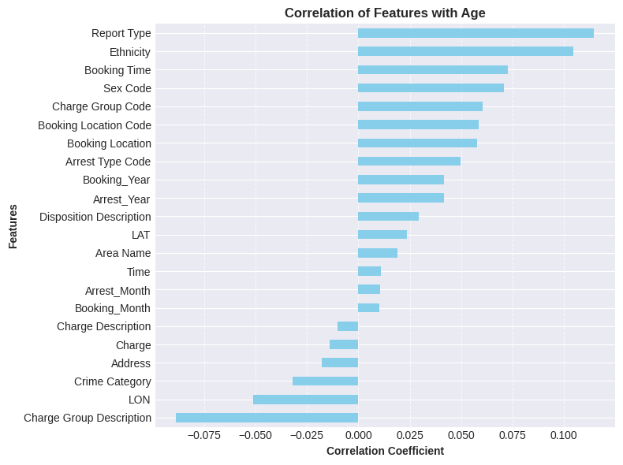
Why is it bad?
AGE
Most of the features don’t have a high correlation with Age.
The ones that the models should target are:
Report Type
Ethnicity
Booking Time
Sex Code
Charge Group Description
Notes:
Remove Age from graph to get rid of skew

Slide 34
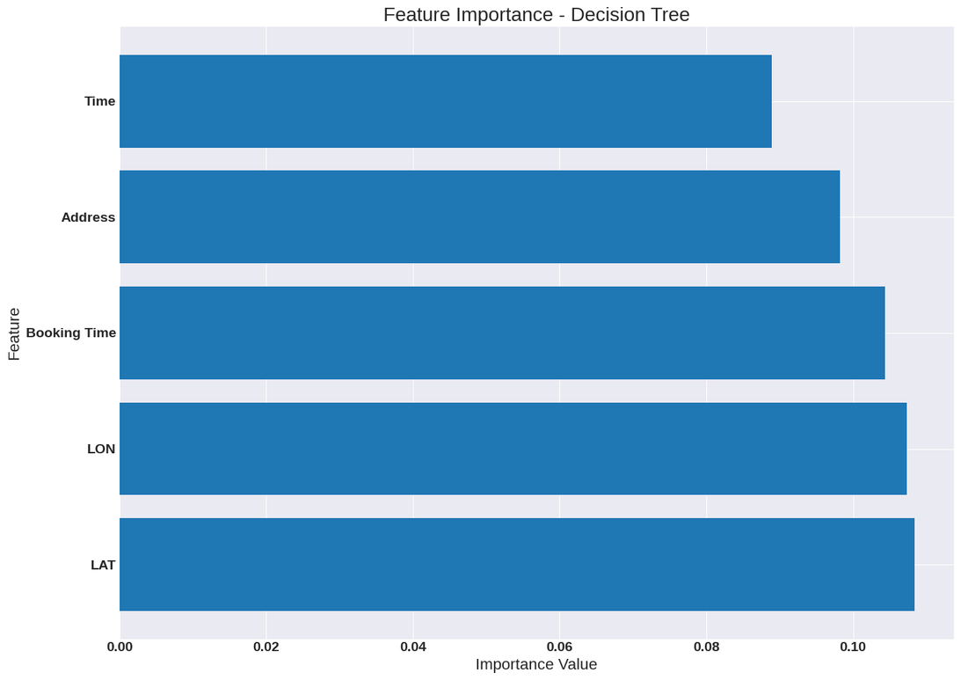
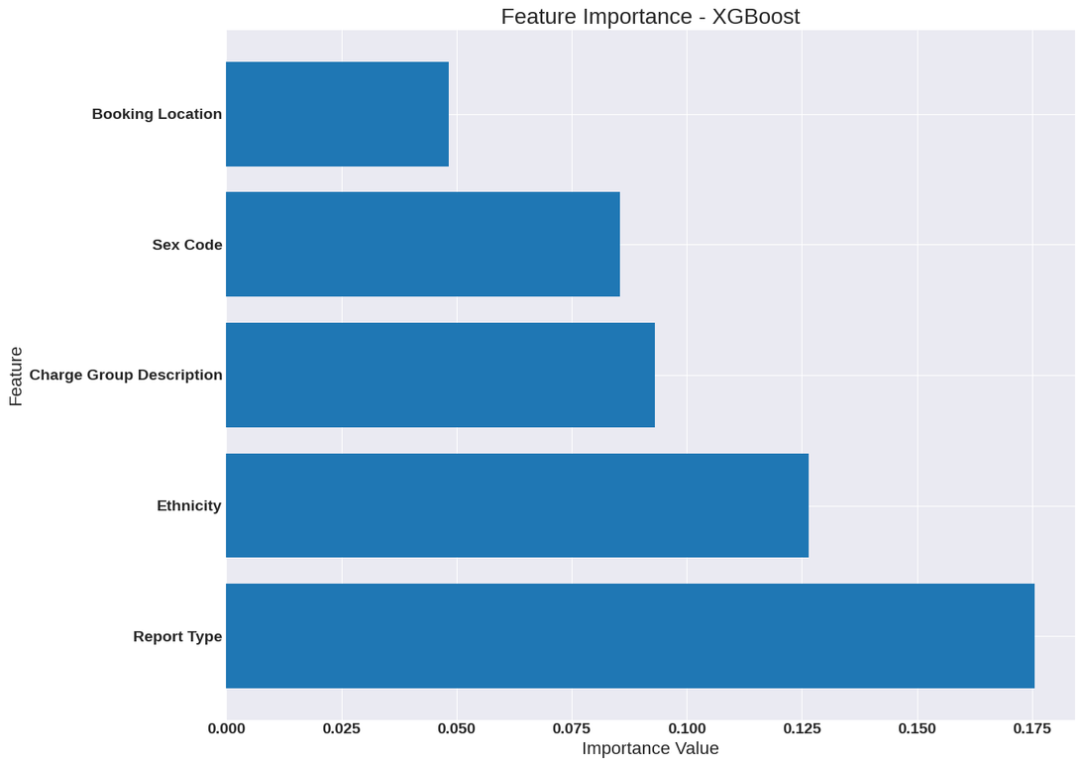
Why is it bad?
AGE
Top 5 Correlations
Report Type, Ethnicity, Charge Group Description, Booking Time, Sex Code
Decision Tree has 1 of the 5
XGBoost Model has 4 of the 5
Features & Correlations make sense, yet the model is not great

Slide 35
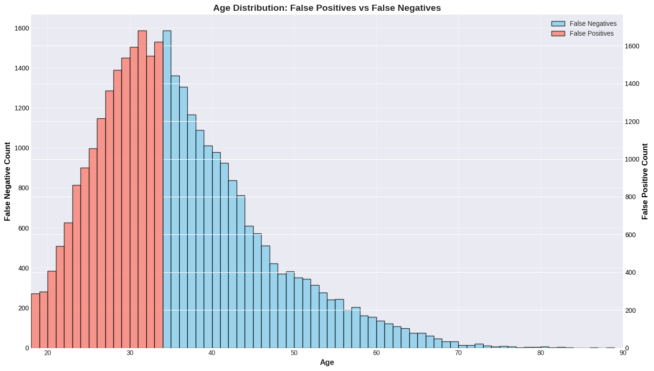
Why is it bad?
AGE

Slide 36
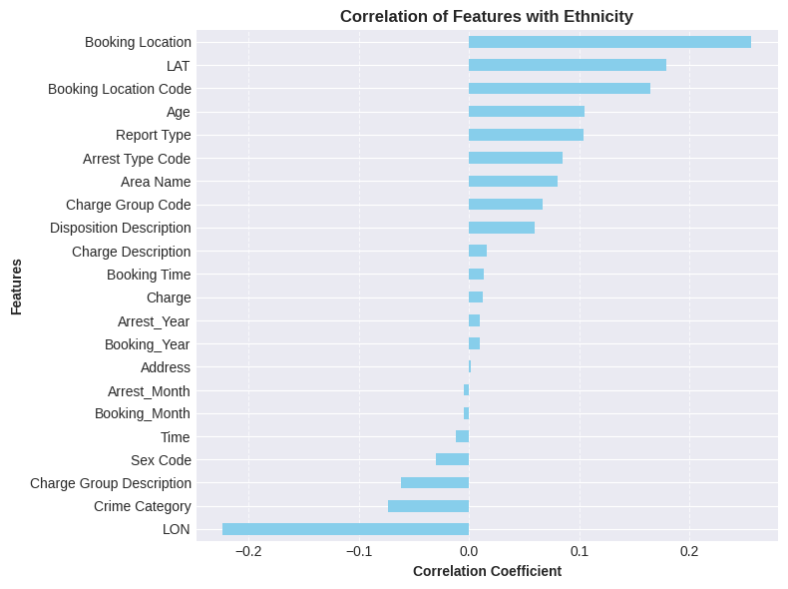
Why is it bad?
ETHNICITY
Significant correlation:
Booking Location
LON (Longitude)
LAT (Latitude)
Booking Location Code
Seems like the model should predict mostly based off of location

Slide 37
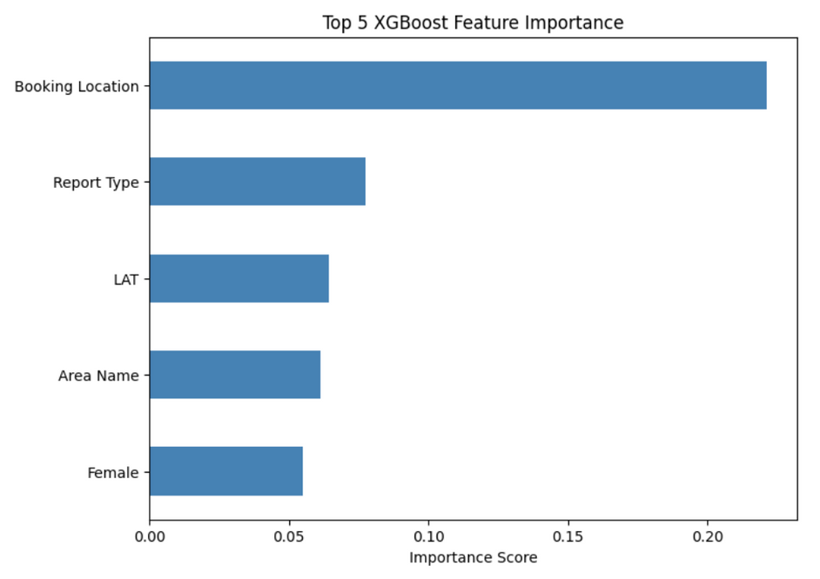
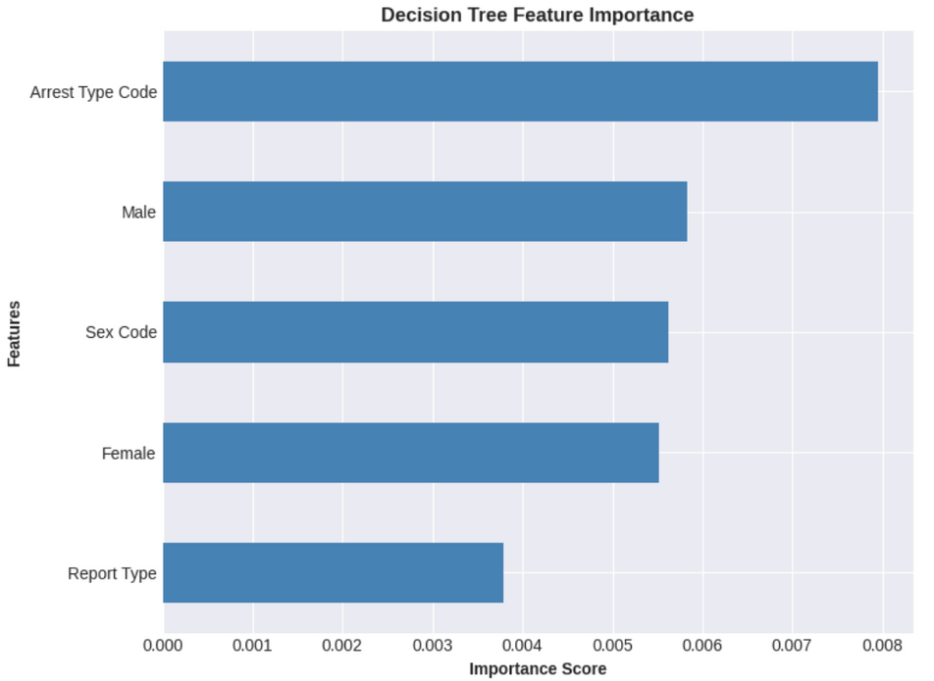
Why is it bad?
ETHNICITY
Top 5 Correlations
Booking Location, Location, LAT, LON, Booking Location Code
XGBoost Model has 2 of the 5
Has almost the same performance as the ensembled model
Decision Tree has 3 of the 5
Worse than the XGBoost model

Slide 38

Why is it bad?
ETHNICITY
Most important features and highest correlated columns mostly match
Models predict mostly from best available columns, yet they are still bad
Makes sense
Columns are not highly correlated in the first place
They can be used to predict to a certain extent
Lets take a closer look ->

Slide 39
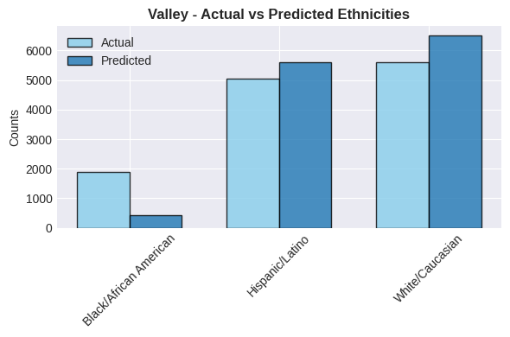
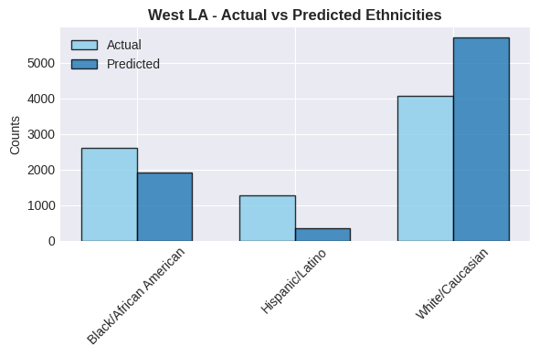
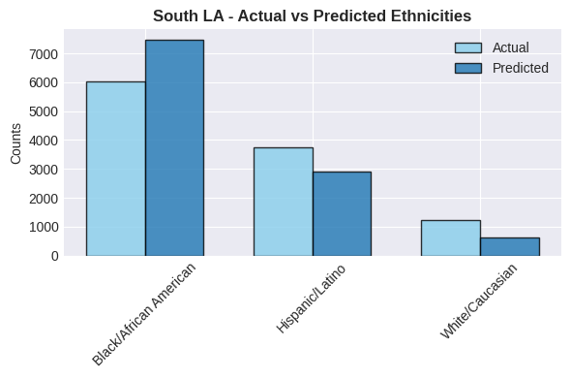
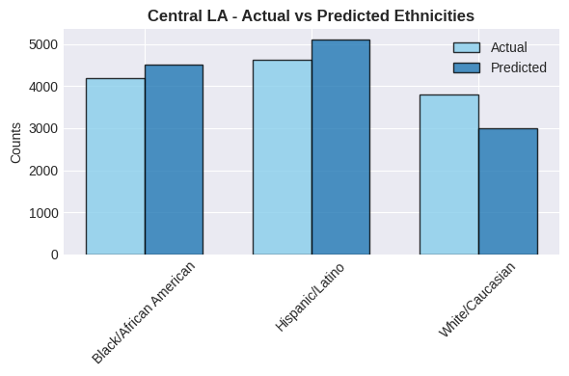
Valley
West LA
South LA
Central LA

Slide 40
CONCLUSION
Gender
Able to predict Males very well, but struggles with predicting Females
Slightly biased towards Males
Age
When Age is near the threshold value, model is essentially doing a coin toss
Hard to tell apart a 33 year old from a 34.
No highly correlated columns means there is no clear pattern the model can learn from
Ethnicity
Model relies on Location based prediction
Model gets biased by the Ethnicity that predominates a particular Region

